Slide 1


Aws cloud formation

Slide 2

WHAT cloud formation
Simplify Infrastructure Management
Quickly Replicate Your Infrastructure
Easily Control and Track Changes to Your Infrastructure

Slide 3
WHAT cloud formation
Templates
Stacks
Change sets

Slide 4
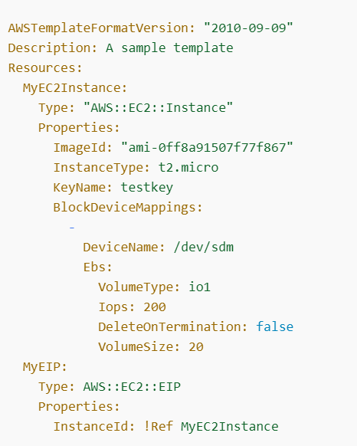
WHAT ARE templates
Json or YAML formation file structure for your infrastructure
https://docs.aws.amazon.com/AWSCloudFormation/latest/UserGuide/cfn-whatis-concepts.html

Slide 5
stacks
Collect related resources together:
RDS
EC2 instance
Load Balancer
Create, Destroy them together

Slide 6
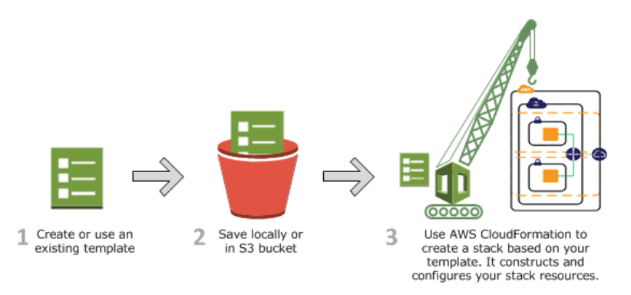
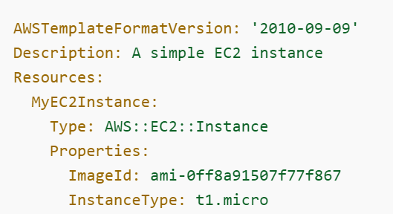
How cloud formation works
Create stack document.
Store in own S3 bucket and location or AWS create the bucket and store the file
Ensure you have all necessary IAM permissions

Slide 7
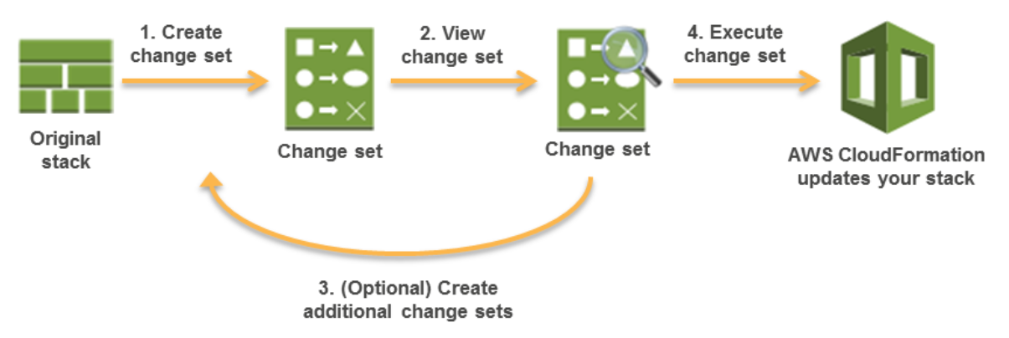
changesets
Update the stacks by prechecking any issues upon changes.
Check and then apply the changes

Slide 8
How cloud formation works
Create stack document.
Store in own S3 bucket and location or AWS create the bucket and store the file
Ensure you have all necessary IAM permissions

Slide 9
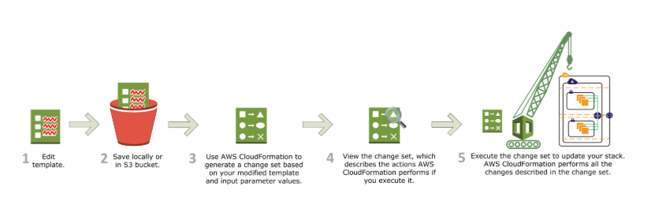
How cloud formation works

